Slide 1
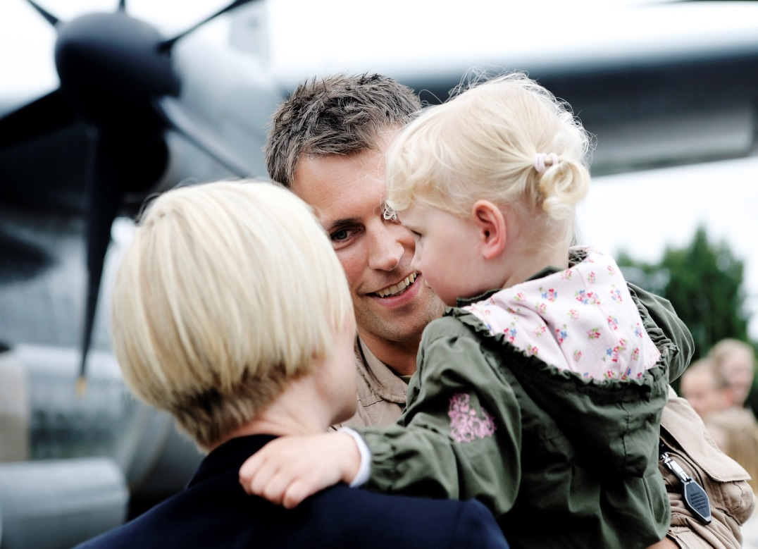
The veteran experience from a spousal perspective
Elin Gustavsen
PhD student
Norwegian Institute for Defence Studies

Slide 2
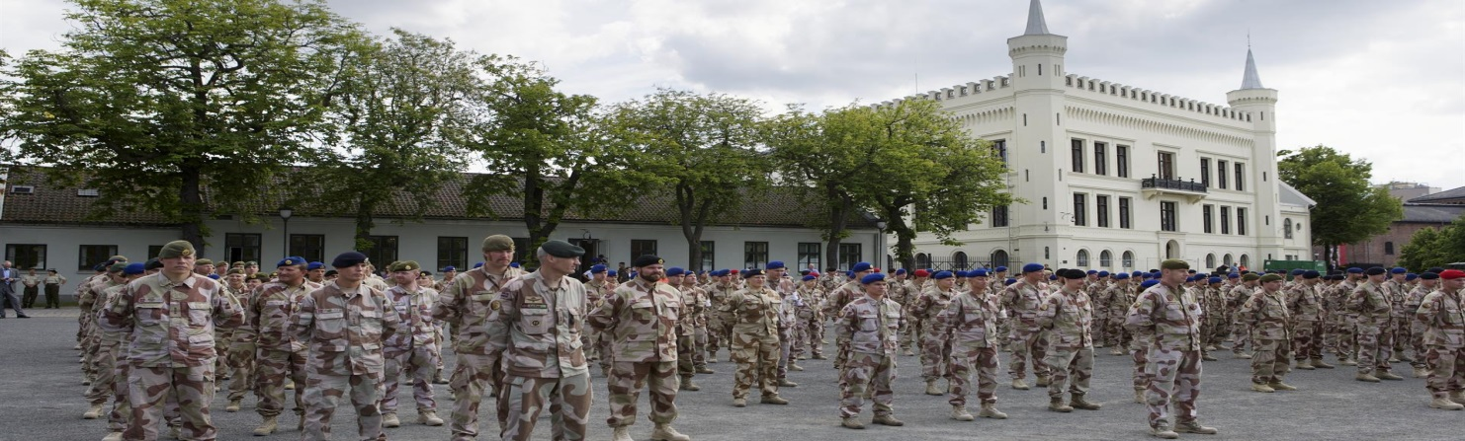
The study
Narrative interviews with ten women
Age 31-47
Married or longtime co-habitant with an Afghanistanveteran
One divorced with shared costudy of children
Phenomenological approach
Lived experience
Meaning meaking
Cultural study
Understand their meaning making in light of the Norwegian cultural
and societal context
Notes:
Narrative interviews with ten women
8 interviews – age 31-47 – married or long time co-habitant with an Afghanistanvetern/
one divorced woman with shared costdy of two children – her story revealed how things can play out shared foundation is not there – highlights central aspects of other women who accepted conditions
Phenomenological approach – lived experience – meaning making
Narrative interviews goal to collect the individual stories of spouses – less structured than semi-structured thematic interview – follow the participants down their trail, tell story with limited interference – no preset list
Cultural study – understand their meaning making in light of the Norwegian cultural and societal context
why they engaged in the meaning making strategies – context provide certain tools shape how they interpret the experience

Slide 3

Methods and analysis
Interviews lasted from 1-2
hours
Looking for shared themes,
but also variation in experience
Norway as cultural context
Peaceful society – no shared war experience
Veterans do not have a highly visiable position in society
Gender equality as sameness
Notes:
Interviews lasted from 1-2 hours - All interviews fully transcriped - interested in contend of what is told, not how meaning is created during the conversation or discourses are constructed
In the analysis of the interviews I will look for shared thenes, but also variation in experience across the sample
Always interesting to see what participants have in common - default mode patterd in the data
From a phenomenological perspective equally important to document the variation in this experience and what characterizes the story of each woman
Analysis weave together general themes and variation in the stories into a comprehensive account
Produce rich data – neuanced understanding of this instance of lived experience through the eyes of the women I interview
Three things to note about Norway as a cultural context:
Peaceful society - very protected lives. No shared war experience - last war on our own soil was 70 years ago -participate in a military operation foregn reality – hard to relate to take an interest
Veterans do not have a highly visable position in society – military family not an established concept
Dominant notion of gender equality – equality as sameness – not just equal rights, but equality in result
Do not follow the dominant notion of gender equality in Norway, which is to share all responsibilities 50-50 – both partners participate equally in the home
These families have arranged their lives large extent according to the mans job: move, frequent absences expersieces deployment – women take a larger responsibility for family life at home
Cannot present an analysis of the findings yet – background for the study – present emerging findings from the interviews

Slide 4
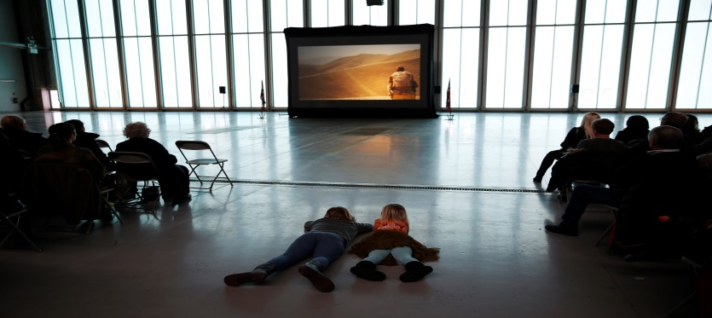
Flexible family narrative
To be a military family is a livestyle, not just a job.
«The entire family is employed»
The armed forces as a continious part of their relationship story.
Shaped expectations and how they organize their life
Military family as a shared family project
The women fully support the project
The deployment a legitimate aspect of their family project
Notes:
A shared interpretation to talk of the deployment as part of a flexible family narrative
Emphasize that to be a military family is a lifestyle, not just a job
Not just the hudband who work in the armed forces, like «The entire family is employed»
Well adapted to a lifestyle of adjustments
Not always easy - but the deployment was not considered a major interuption to regular life
Used to show flexibility to meet the demands of the armed forces
The armed forices had for most women been a continious part of their relationship story
When they men their husband or partner he was already in the military
Shaped their expectations and how they organize their life – flexible family always been the norm for them
The deployment expected and something they were prepared for – used to extended seperations
One spouse, perhaps most well adjusted, «it’s just like a long exersice» - not an unique occurance
To be a military family narrated as a shared family project
The women fully supported and were an essential part of. - to deploy was considered a legitimate aspect of the overall project

Slide 5
It is a lot of the armed forces, it impacts your life. It’s not just a job, it’s a lifestyle. We have to plan more in advance. Exercises when he is gone for a time, vacation planning, social events. It is a big part of life and everyday life to have a [man] who is in the armed forces. […] We’ve never really had a lot of time together, as long as we’ve been together he has always been away for periods. How I see it today it’s perhaps nice, now and then I like having some time alone. So I don’t know what it is like to have a man how is present all the time.
- Longtime co-habitant, early thirties, two children
Notes:
How one woman talk about the how being a military family is a lifestyle
QUOTE
An how the armed forces has been a continious part of her relationship – how it has always been for them – used to to it impacting her life in many respects
Also demonstrate how she has come to value certain aspects

Slide 6
I am used to lying in bed alone and to deal with things alone, and I think that have strengthened me, ok, we can do this too. Not just when he was commuting, but exercises and courses, you are more or less used to those things. So definitely, that had a lot to say. If we’d been together every day and suddenly he was gone I think it would be difficult.
- Wife, mid-thirties, two children
Notes:
Here is how another participant talk about how the lifestyle has prepared her for the deployment
QUOTE
She is used to manage by herself – normal part of her everyday life

Slide 7
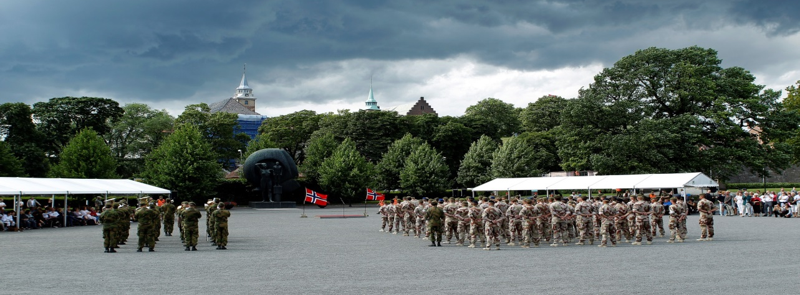
Narratives of seperating and integrating their spheres
Individual variation in the concrete responses to the deployment situation
The different stories center around two axis:
Seperating their home sphere from the deployment
Integrating the experience into their home sphere
Notes:
There were also notable variations among the spouses in their concrete responses to the deployment situation.
They presented many concrete stories from the separation and also the strategies they engaged in to respond to the situation
Demonstrate the variety of this experience and their individual responses
Although the concrete stories the women tell showed great variation, they did tend to center around two axis and communicate two overall narratives:
On the one side, the women separated their home sphere from the deployment
- compartamentalizing their existence and life at home from the deployment
On the other, they present a narrative about integrating the two spheres in a purposeful manner into their everyday life
make an effort to integrate their individual projects into the military life style - more integrate the deployment experience into their home sphere
Balancing act – keeping the necessary distance – not reject it
Through their stories, the women present themselves as actively taking part in shaping and responding to the situation
Rather then perciving the deployment as a burden to overcome they were careful to demonstrate agency and ownership of the situation

Slide 8
I have never worried for what he does, that has never been a problem for me that I go around and am afraid. Not because I don’t care about him or that something might happen, but I think he is a grown man and has, kind of, made his decision. I am conscious about being able to manage by myself.
That’s kind of his responsibility. I wouldn’t appreciate if someone forced me into a job I didn’t like, the same way I don’t want to force him into a job he doesn’t like. But it is his responsibility.
- Wife, mid-thirties, two children
Notes:
For some women it was important two draw a very distinc line betwee themselves and their husbands autonomy in this situation – making the decition to work in the armed forces – as a consequence deploy
Example form one participant, she was very supportive of her husband and his career in the armed forces
He communted during the work week, so then she was alone at home with their two girls, and she was okay with that and did not complain
But, she was very contious about not her husbands job, and to deploy which follows from it, being his decition - something she did not interfere with
QUOTE

Slide 9
I don’t need to know everything, because I think he shares what he wants to share, and he can share the rest with the other men. […]It’s nice when he shares and talks about it, but I think it doesn’t matter that much, for my sake, exactly what happened there [in Afghanistan].
- Wife, early forties, three children
Notes:
Many of the women, in fact most of the, had a limited interest in knowing too much of what had happend in Afghanistan during the deployment
It was of course nice to hear some stories here and there, but no need to get a detailed account or the full story
Belonged to their husband or partners sphere – not need to get to get too involved
QUOTE
After return, the deployment was not a major topic in ther lives – overwith, back to their regular routnies

Slide 10
It’s important for me to be able to talk about things in daily life, what happens here in Norway. Because this is actually the life we live and not get hung up in what happens in..away where they are. Because that is a different life. […] When they struggle at home with children who don’t want to listen and things like that, and then your spouse is in the operation with a child that is barely alive and says you have to stop complaining at home, here it is death. And then it is like, yes, but it is two worlds that needs to be treated separately, not necessarily compared [in order] to see challenges from two different perspectives.
- Wife, early forties, two children
Notes:
Another strategy especially vocalized by one woman was to deliberatly allow herself to be focused on home life, even though things are much worse in Afghanistan.
Important for her not having to compete with that domain
Very eplicit about the importance of treating the two spheres seperatly
QUOTE
Interesting is that what appeard to be the most difficult to deal with during the deployment were the times when the two spheres overlaped, which created a state of limbo
Preparing for the upcomming tour - away a lot, but had not officially left - their mind was already in Afghanistan
Leave periods, when they are home for two weeks. «They could almost have skipped that leave period. You do anticipate that in two months he will be back, but its not really anything to look foreward to»
interuption of their home sphere
Debriefing - spend three days at a hotell to debrief before landing in Norway – knew they had left Afghanistan, but not home yet

Slide 11
[He asked] how could she have allowed him to go to Afghanistan. ‘Allow him to go’, I replied, we have decided this together and this is his job, that’s how it is […] I was almost insulted. Did they really believe we hadn’t thought this through?
- Wife, late thirties, two children
Notes:
Even though the women told stories about maintaining a distance to the deployment - also worked to integrate it into their life in a purposefull manner
Important to demonstrate ownership to it – brings us back to this being a shared project – important to emphasize not forced upon them or reluctantly accepted
Brother-in-law had questioned why she had allowed his brother to og QUOTE

Slide 12
I have normalized it in a very nice way, I think, because I don’t accentuate it and I don’t disown it. So, our everyday life has gone about and there are many who don’t..I haven’t always bothered to tell [people] that he is away, either. So they have been surprised that ‘wow, is he away’ […] I have a very normalized view on it.
- Wife, late forties, two children
Notes:
One woman – most extensive experience - talked about the importance of normalizing the occurance - treating it was an integrated part of their life - not something to make a big deal out of
Not all put it that directly, but the notion of not treating the deployment as a big happening or an interuption of their way of life - ties into the flexible family narrative

