Slide 1


Slide 2

Supporting the troops: The effects of Estonia’s veterans policy
Tiia-Triin Truusa

Slide 3
Towards veterans policy
1991 Estonia regained independence
1995 deployments starting with operations in Croatia and Lebanon
2003 Estonia deployed to Iraq and later to Afghanistan
2004 NATO full membership
2012 First veterans policy

Slide 4
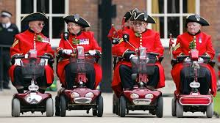
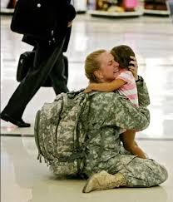
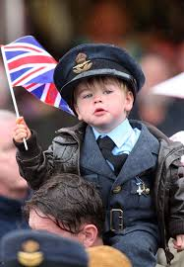
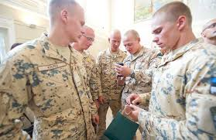
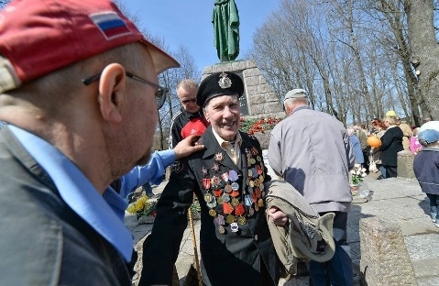
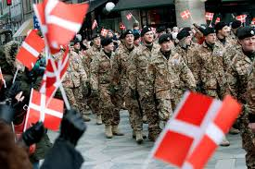
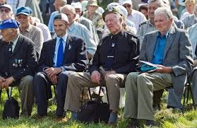
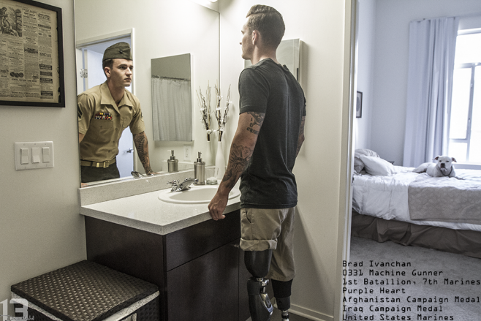
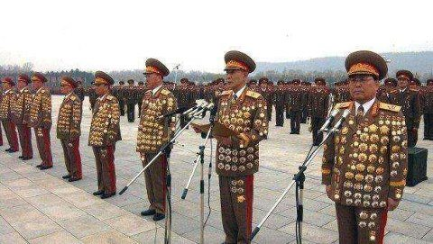

Slide 5

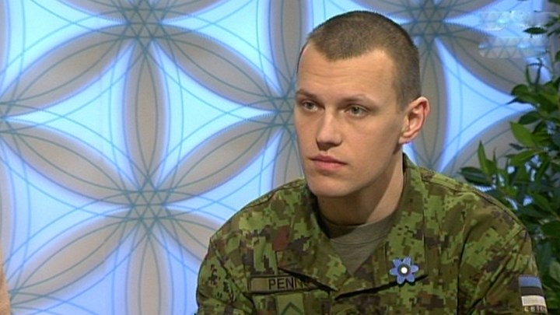
The Estonian veteran

Slide 6
Promoting Social Recognition
Veterans Day
Strengthening support from civil society and the private sector
Promoting charity
Supporting veterans associations and civic associations that support veterans
Promoting broader publicity
Educating people about veterans policy

Slide 7
Aim
My aim was to map the effects of implementing the Veterans Policy in 2012, with the emphasis on social recognition.
Social recognition
The individual is part of the group or society’s solidarity and is a positive contributor for the group or society’s organization and reproduction .
Honneth 1992

Slide 8
Objectives
1) I collected articles in the Estonian printed press from tw periods:
2007-2010 . Using key words: Afghanistan, war in Afghanistan, Iraq war, Iraq, social benefits, rehabilitation, injured, mental health, suicide, family
2012-2014. Using key words: Afghanistan, war in Afghanistan, Iraq war, Iraq, social benefits, rehabilitation, injured, mental health, suicide, family, veterans, war veterans
2) Selected articles pertaining to social recognition
3) Analysed to determine if any and what are the differences in how veterans are portrayed before and after Veterans policy

Slide 9
Method
Method: qualitative text analysis, using MAXQDA
Open coding thematic coding.

Slide 10
Results
Articles 2007-2010
Themes:
Veterans are misunderstood
The Estonian state and society are unappreciative of veterans’ sacrifices
Veterans’ needs are not met
International comparisons where Estonian veterans loose out

Slide 11
Results
Articles 2012-2014
Themes:
Veterans are heroes, who protect us
Veterans are resilient and persevere
Veterans give back to the community
International comparisons where Estonian veterans loose out

Slide 12
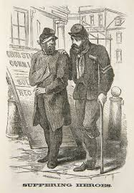
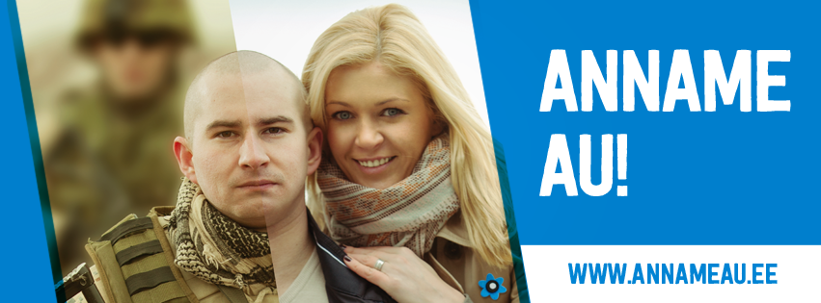
Changes

Slide 13
Why?
Targeted media campaign
Easing of the deployment burden
No casualties
The changed security situation
  Events in the Ukraine

Slide 14
Continue SR campaign
Push for „Big Society“
Civil-military gap
Tiia-Triin Truusa
tiia-triin.truusa@ut.ee

